Slide 1
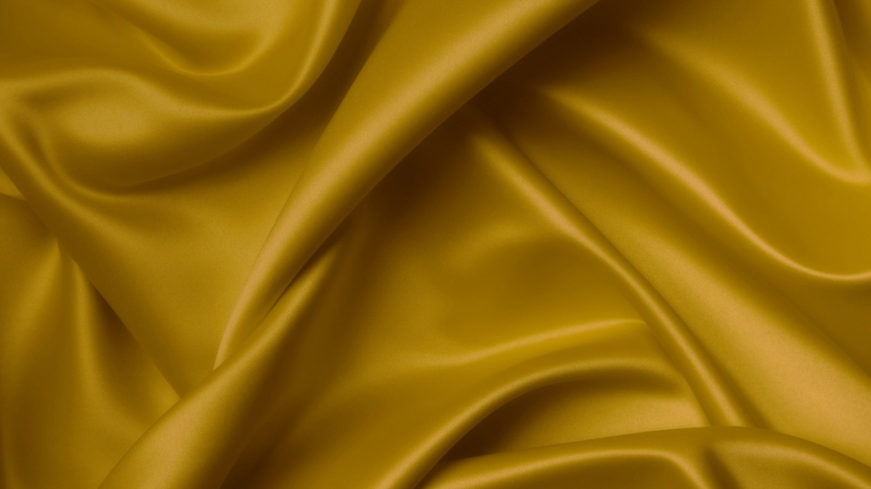
Once Upon an Image File
Shakira Kashif
Devin Prikryl-Martin
Christian Mpabuka
Piero Suarez Prada
Houston Community College
ITAI 1378 Computer Vision
Professor Patricia McManus
September 18, 2024

Slide 2
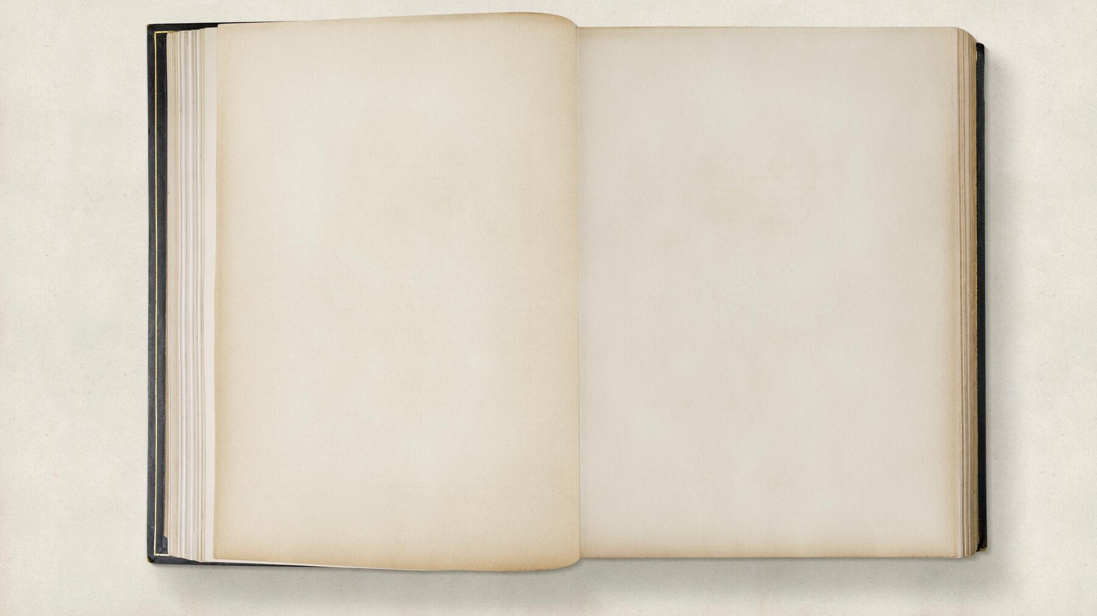
In order to sustain peace, the Queen thought it best to bring all the lords together for a great feast where the Queen could show her lords that all their differing needs could be met without resorting to violence. The King, inspired by the Queen’s mission and his love of cuisine, offered to design a menu for the feast based on what the Realm of Image Formats has to offer their lords.
O
nce upon a time the Realm of Image Formats was in danger. Queen RGB had seen that the Lords of Algorithmia who oversaw the provinces of her kingdom were beginning to squabble over which format was superior. She knew if she did not intervene, the kingdom would soon be at war.

Slide 3
The menu will go here

Slide 4
The day of the feast arrived, as did the Lords of Algorithmia. They were ready to start a war then and there, but when presented with the royal menu their minds and hearts changed. They realized there were enough formats to satisfy all of their needs and cravings. They left that day, jovial and the King and Queen were satisfied that peace would continue in the Realm of Image Formats.
The End

Slide 5
Citations
This assignment was informative and a bit challenging. I was only casually familiar with the image formats prior to this module. I had heard of each format and encountered them but I couldn’t have told you why one format should be used over another. Now I have a much better understanding of what makes the formats different and useful for different tasks. JPEG is the most common image format, primarily because it utilizes a compression algorithm to make large images take up a small amount of storage. It is widespread across platforms and is commonly used on the web. JPEG is not an especially good format for Computer Vision because the method of compression used on the JPEGs can create “artifacts” or abberations in the image that can make it difficult to get accurate information from the image. BMP is a less common and older format that is especially useful in situations where high quality, uncompressed images are necessary. The large files preserve all the image data but can make it difficult to process in real time. TIFF stands for “tagged image file format” and is unique because it can store multiple images in one file, and supports high bit-depth. This makes it especially useful in the world of professional photography and in medical imaging. PNG features lossless compression, and is probably the second most common format, often used in web graphics.
Branch Education. (2021, December 23). How are Images Compressed? [46MB ⏬ 4.07MB] JPEG In Depth [Video]. YouTube. https://www.youtube.com/watch?v=7oskYV4HrXs
What are TIFF files and how do you open them? | adobe. (n.d.-a). https://www.adobe.com/creativecloud/file-types/image/raster/tiff-file.html
Gosling, M. (2020, July 14). What type of file do I need for printing?. Metro Imaging. https://metroimaging.co.uk/what-type-of-file-do-i-need-for-printing/#:~:text=Some%20image%20types%20such%20as,they%20are%20most%20suited%20for.
What is a Bitmap (BMP)? - Definition from Techopedia Margaret Rouse 12 December 2017
Adobe. (n.d.). What is a PNG file? Adobe. https://www.adobe.com/creativecloud/file-types/image/raster/png-file.html#:~:text=What%20is%20a%20PNG%20file,transparent%20or%20semi%2Dtransparent%20backgrounds.

